Slide 1
Stop Motion Club 2022

Slide 2
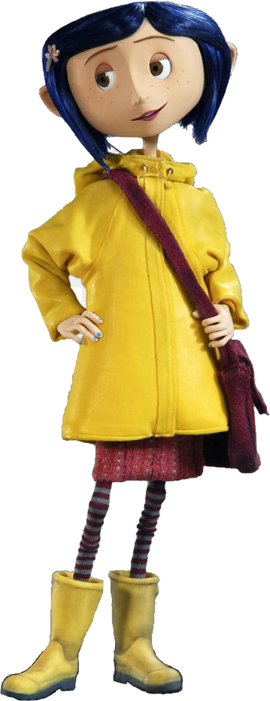
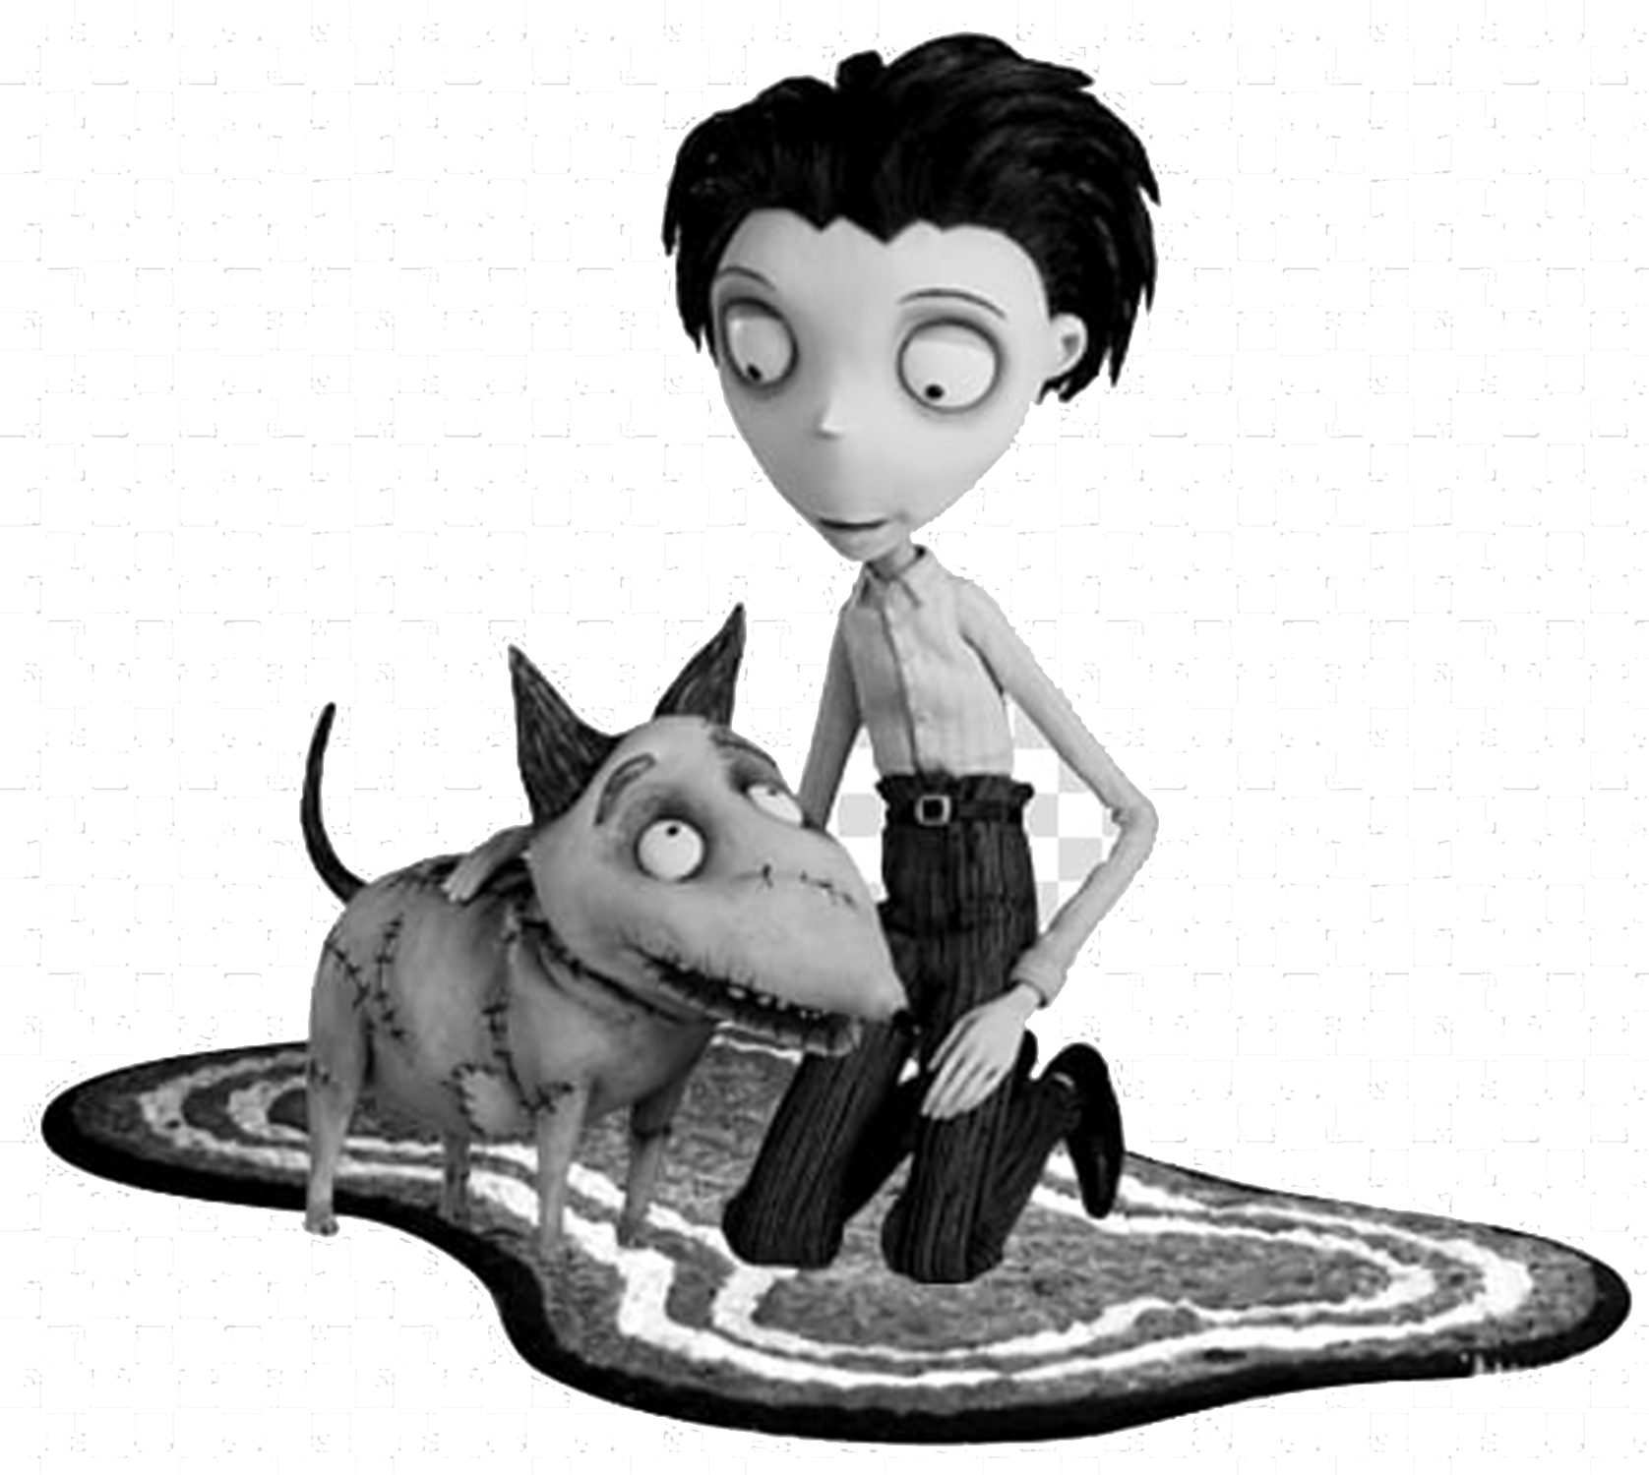
Why Are we here?

Slide 3
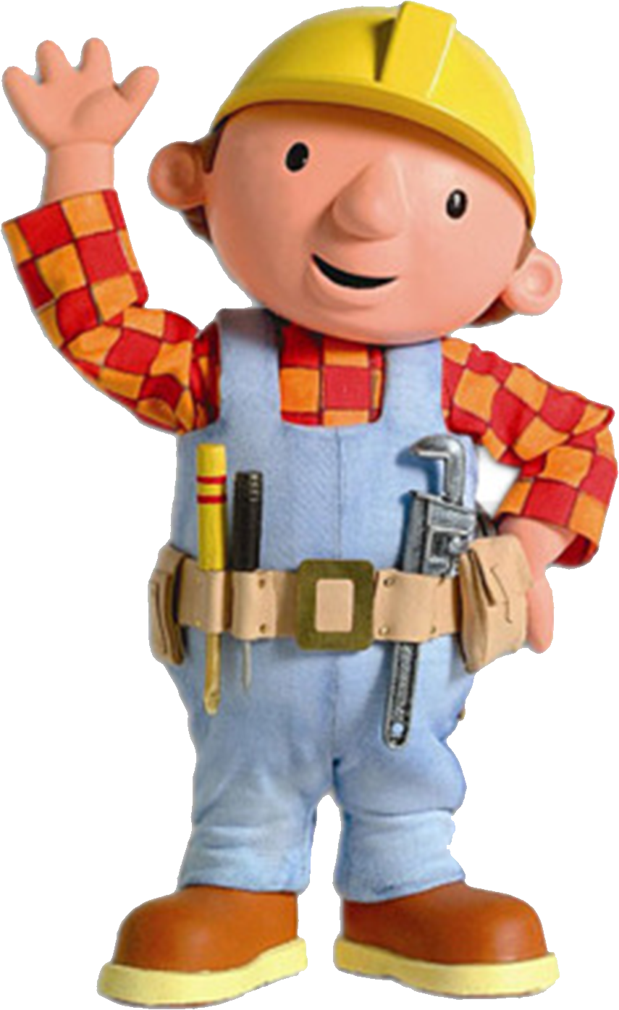
Think Big. WORK SMALL.
Your creativity is not confined to what’s possible in the real world

Slide 4
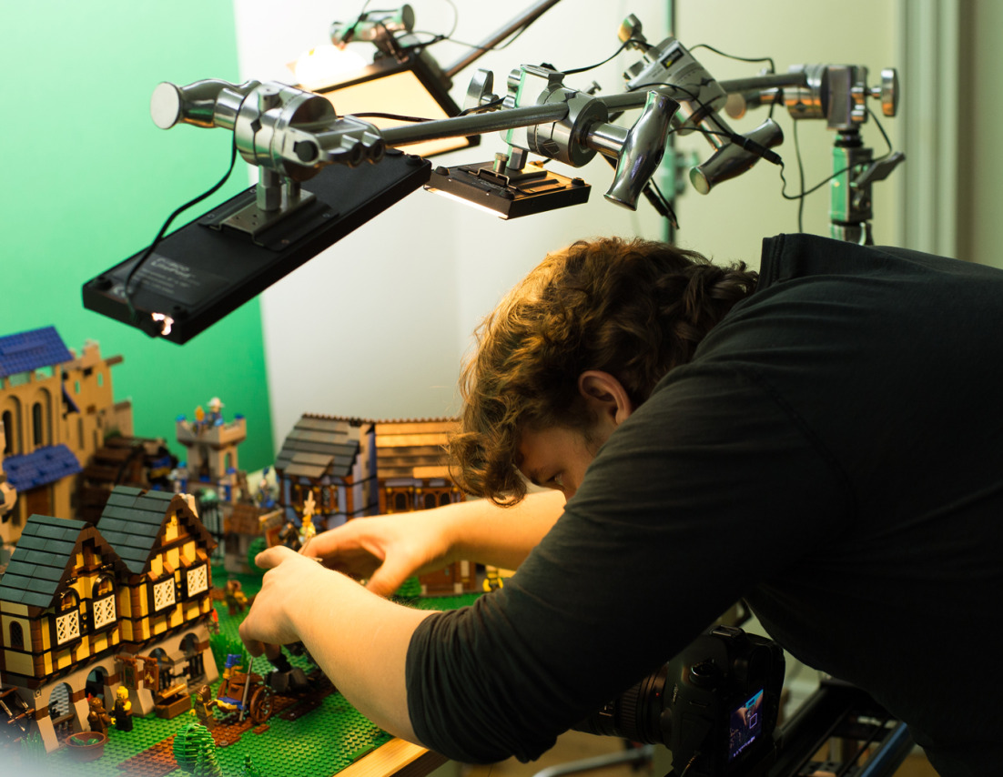
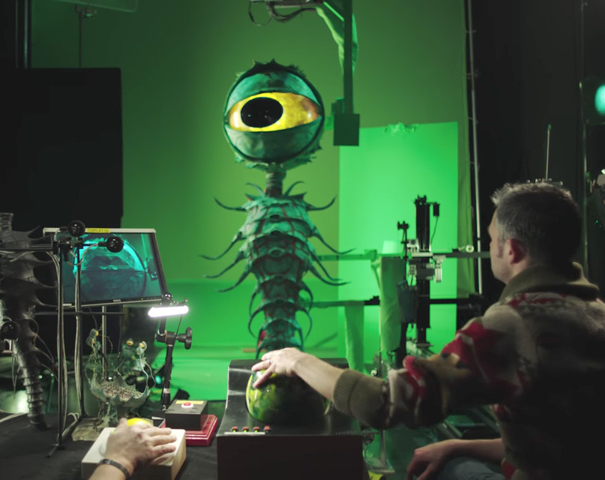
Learn the secrets to video production
We will learn how to make any kind of film or video. Not just how to work with stop motion

Slide 5
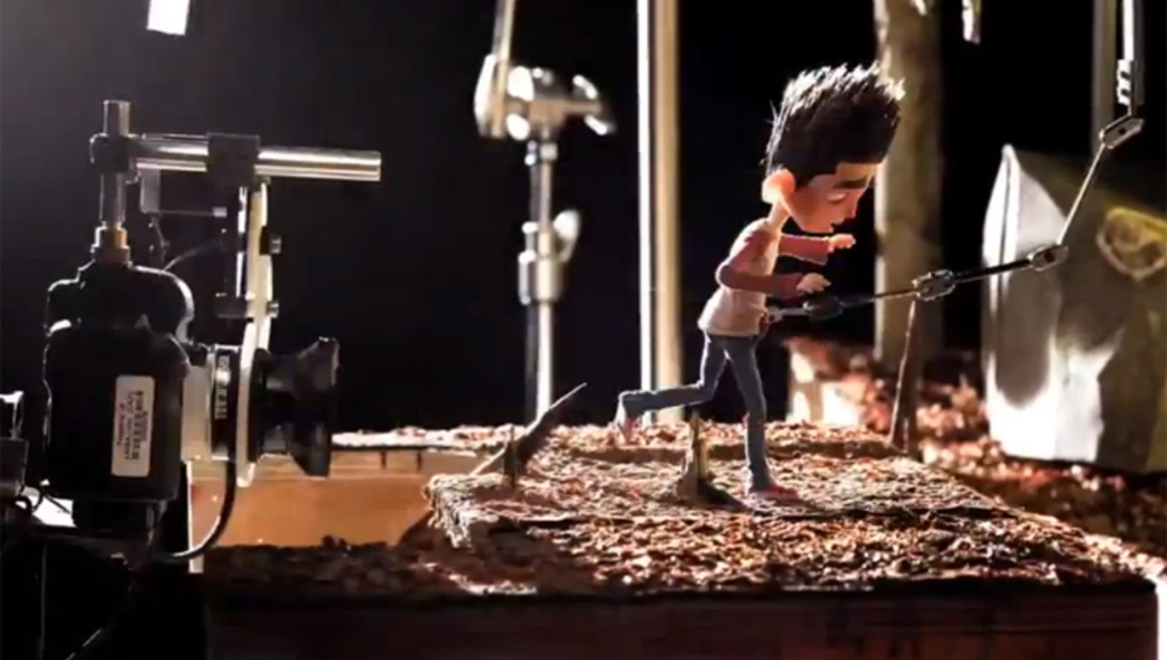
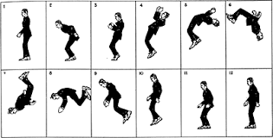
WHAT is Stop motion?
A series a pictures, that when played quickly, looks like video footage

Slide 6
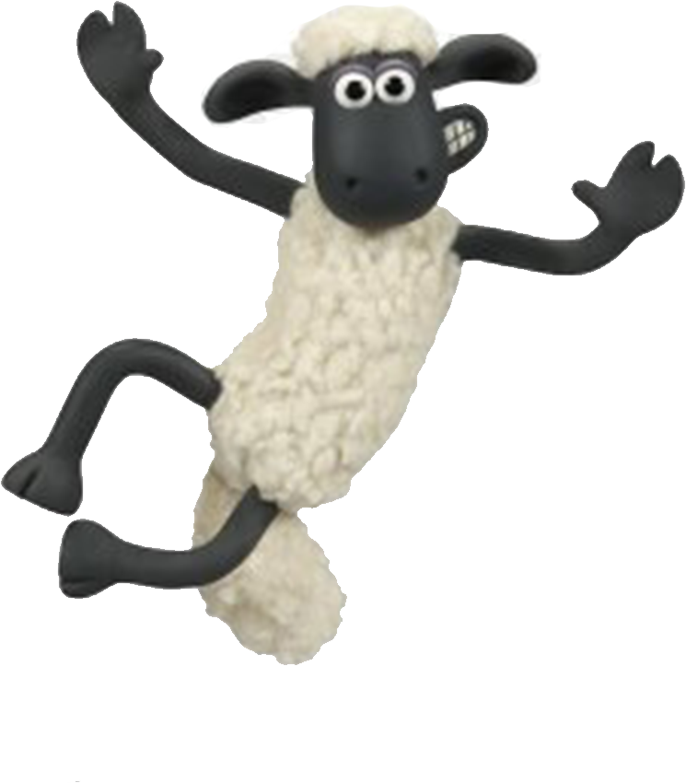
Share our Work!

Slide 7
How to Use Stop Motion Studio
Stop Motion Studio is the free app we’ll be using for the class

Slide 14
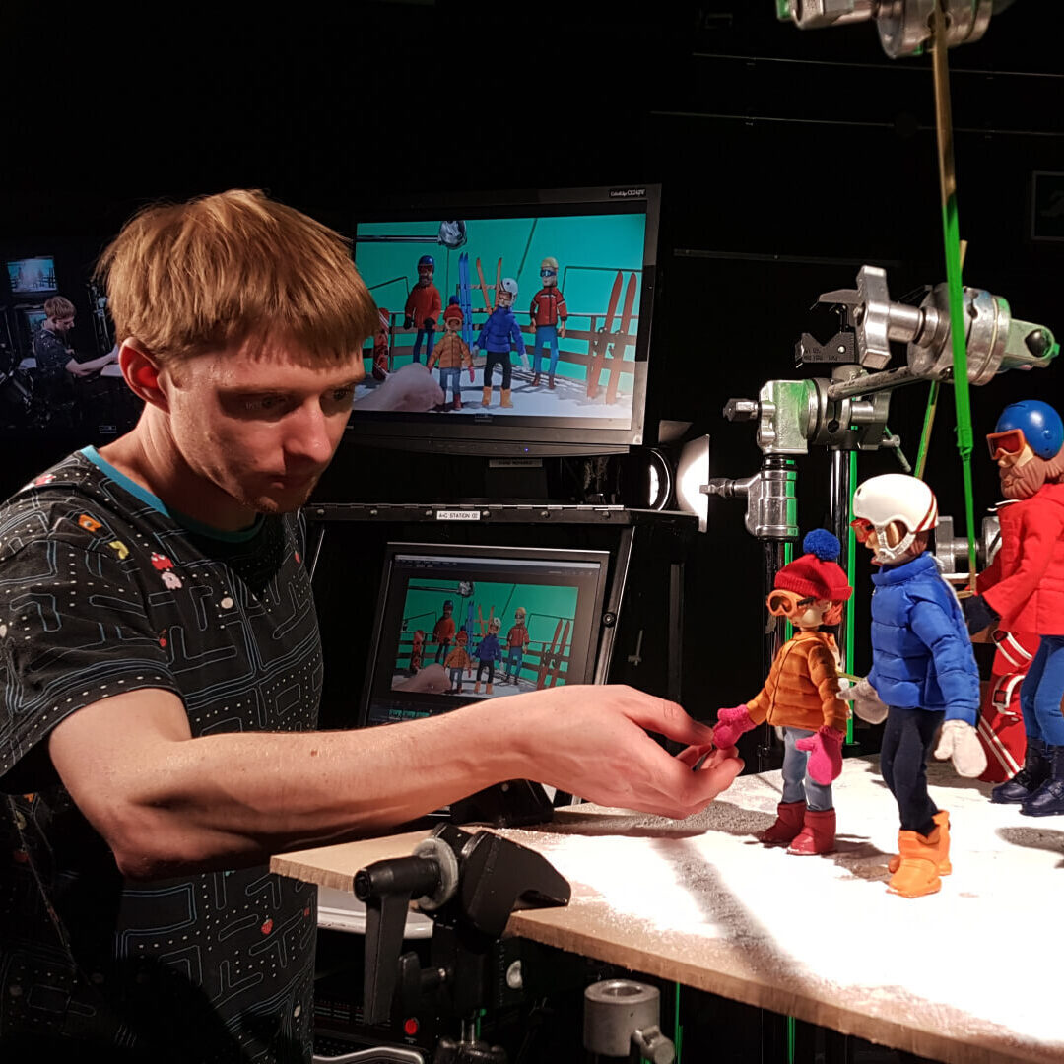
Concepts of photography
Photography is the backbone of stop motion

Slide 15
Rule of Thirds

Slide 16
Points of Interest

Slide 18
Center Of the Frame
Director Jordan Peele

Slide 19
Director Wes Anderson

Slide 20
Low Angles

Slide 21
High Angles

